Slide 1
iCare Health System
SOEN 6471 - Advanced Software Architecture
Team 7
Hebbar Nandakishore
Keerthana Gudavalli
Leili Jahanshahi Monfared
Ozioma Aniagu
Parinaz Barakhshan
Ramandeep Kaur Mehare
Reza Shalchian
Salameh Abdollahi Sohi
Vijay Shah

Slide 2
Contents
Introduction
Motivation
System Stakeholders And Concerns
Architecture Views and Viewpoints
Patterns used
High Level Architecture
Modification
Conclusion
References
Questions

Slide 3
Introduction
iCare is a web based Health Information System(HIS) software.
Which includes:
Patient Health Records Maintenance
Providing E-Prescription/ E-Bill
Supporting Multiple Device Platforms (Desktop, Cell Phones and Tablets)

Slide 4
Motivation for iCare
Quick access to medical information
Quick service to patients
Service to patients at less cost
Clear and open communication with patients

Slide 5
Stakeholders
ID | NAME OF STAKEHOLDER | DESCRIPTION
1 | Project Manager | Supervises, Monitors and Allocate Resources
2 | Architect | Develop and Document the iCare System Architecture.
3 | Maintainer | Fix Bugs
4 | Tester | Tests the System
5 | System Analyst | Analyze The System
6 | Designer | Draws up Detailed Design

Slide 6
Stakeholders (contd.)
ID | NAME OF STAKEHOLDER | DESCRIPTION
7 | Developer | Programmers of the System
8 | User | This is the end user of the iCare system.
9 | Database Administrator | Maintains Data record
10 | Health Care Specialist | An expertise in Medical Science
11 | Hacker | Negative Stakeholder.

Slide 7
Grouping of Stakeholders
Group # | Name | Stakeholders
1 | Owner | Project Manager, Architect
2 | End User | Health Care Specialist, User, Hacker
3 | Administrator | System Administrator
4 | Development Team | System Analyst ,Developer, Maintainer, Tester, Designer

Slide 8
System stakeholders and concerns
STAKEHOLDERS | CONCERN | QUALITY ATTRIBUTE
Development Team | Is the system adaptable to new environment? | Portability
 | Can the system be updated to a new version? | Modifiability
 | Are all the features of system easy to test? | Testability
 | Are features of system able to interact among themselves? | Interoperability
Development Team, End User | Does the system give quick response? | Performance
Administrator | Does the system protect patient information from the unauthorized persons? | Security
 | Is data modified by appropriate user? | Security
Administrator, End User | Does system recover fast from faults? | Availability
End User | Is it easy for any user to operate the system? | Usability
Owner, End User | Is the system affordable? | Cost

Slide 9
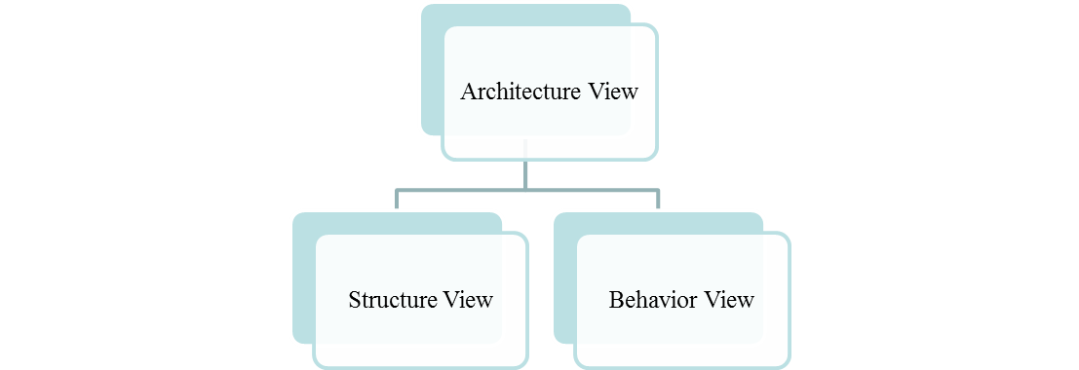
Architecture views and viewpoints
iCare architecture viewpoints are divided into two categories ,including:
Structure Views
Behavior Views

Slide 10
Architecture Views
The Structural View shows static structure of the system and its parts on different abstraction and implementation levels and how those parts are related to each other. It represents the meaningful concept of the system, and may include abstract, real world and implementation concepts.
The Behavioral View shows the dynamic behavior of the objects in the system which can be described as a series of changes to the system over time.

Slide 11
Structural Views
Class Diagram
Package Diagram
C&C Diagram

Slide 12
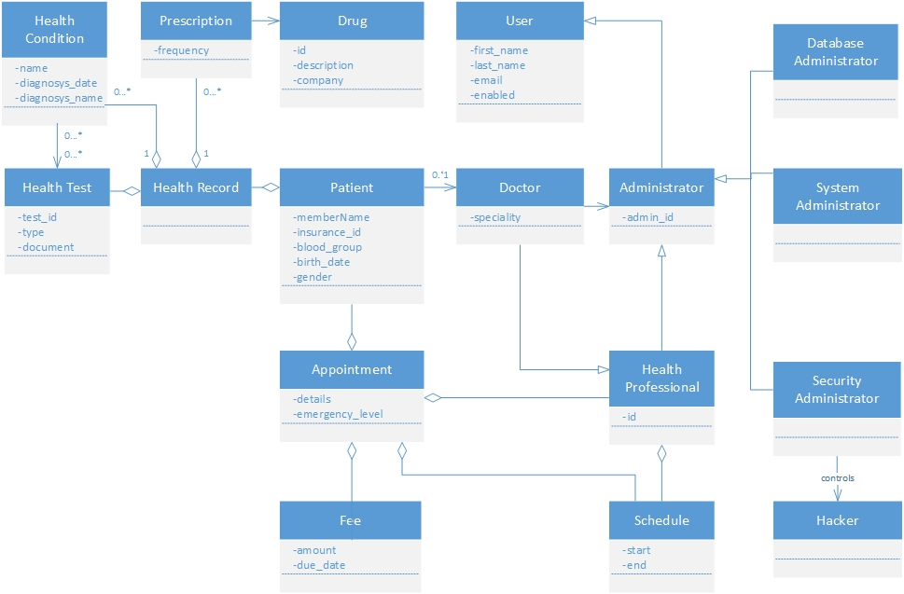
Class Diagram

Slide 13
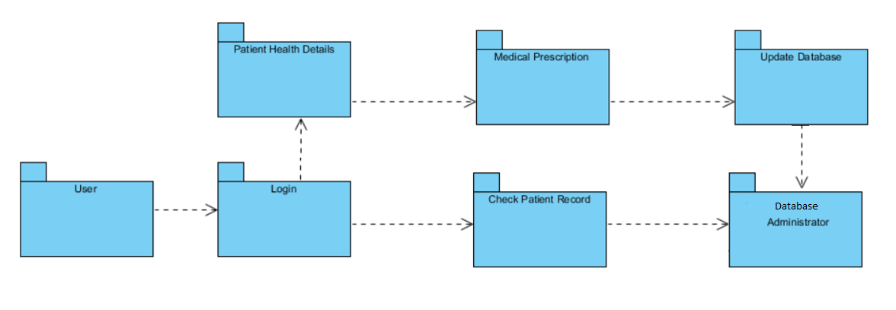
Package Diagram

Slide 14
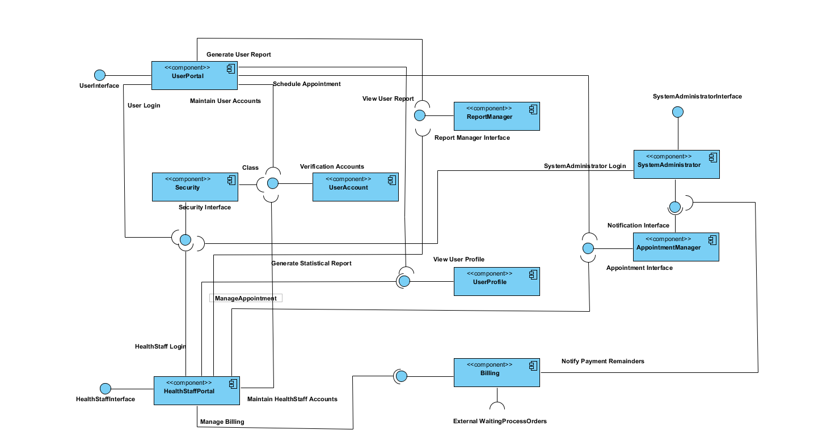
C&C Diagram

Slide 15
Behavioral Diagram
Use Case diagram
Activity Diagram
Sequence Diagram

Slide 16
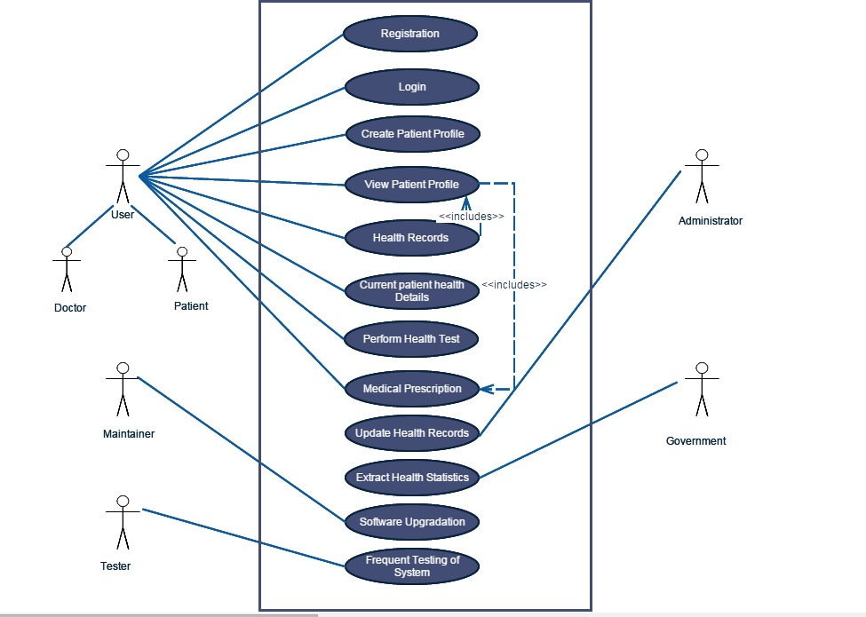
Use Case Diagram

Slide 17
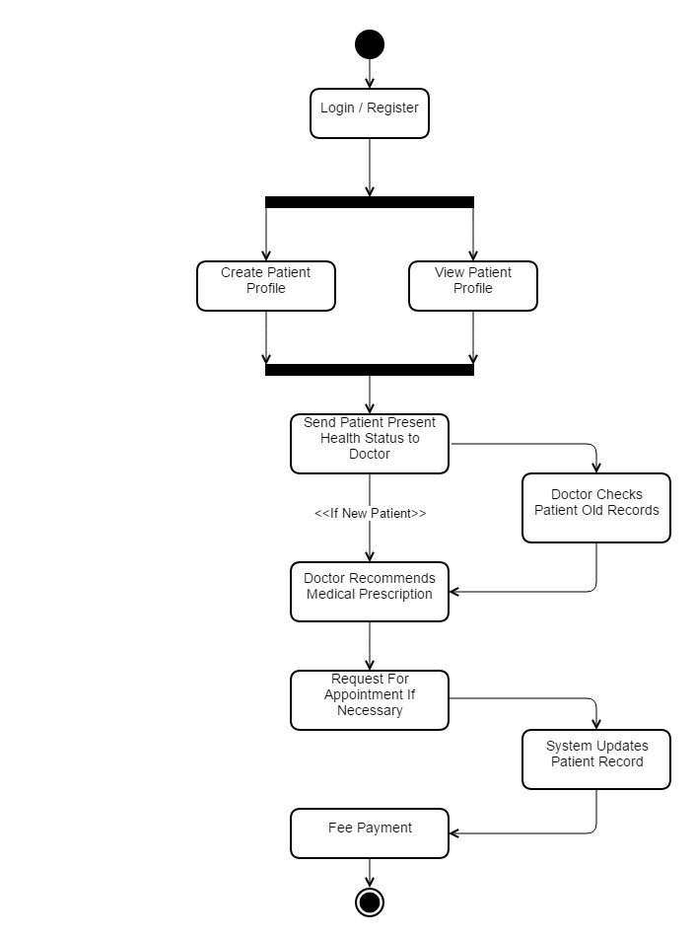
Activity Diagram

Slide 18
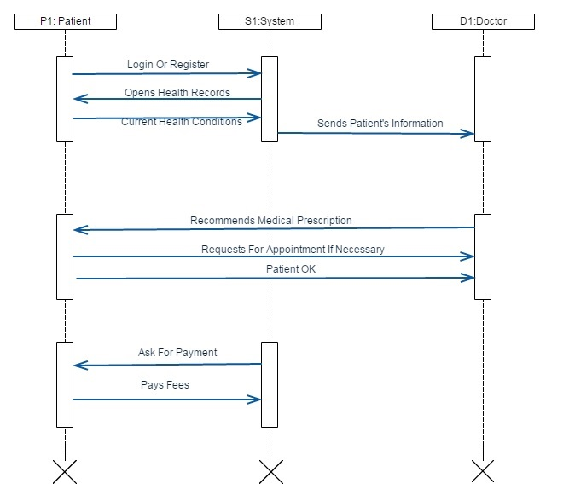
Sequence Diagram

Slide 19
Patterns Used in Architecture
MVC
Layered
Client-Server

Slide 20
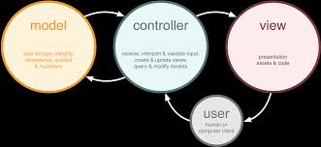
Model View Controller (MVC)
Problem: Separating interface functionality from application functionality and yet still be responsive to user input
Solution: The MVC pattern breaks system functionality into three components: a model, a view, and a controller that mediates between the model and the view.
Strengths:
Separation of Concerns leads to reduction of coupling
Supports Maintainability
Makes Parallel Development Possible
Supports Multiple Views

Slide 21
Layered Pattern
Problem: The software needs to be segmented in such a way that the modules can be developed and evolved separately with little interaction among the parts.
Solution: iCare can be divided into 4 layers: Users, Presentation, Business Logic and Data Access Layers
Strengths:
Supporting portability, modifiability, and reuse
More Flexibility
High Cohesion & Low Coupling

Slide 22
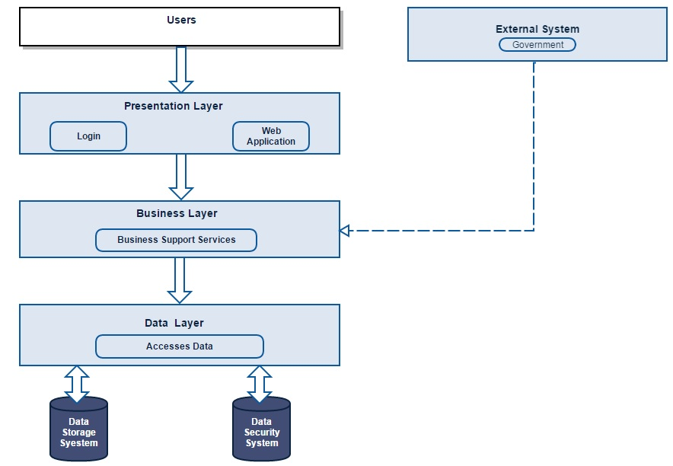
Layered Pattern

Slide 23
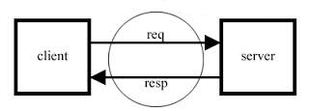
Client-Server pattern
Problem: Improving scalability and availability by centralizing the control of resources and services, while distributing the resources themselves across multiple physical servers
Solution: Clients interact by requesting services of servers, which provide a set of services.
Strengths:
Higher security
Centralized data access
Ease of maintenance

Slide 24
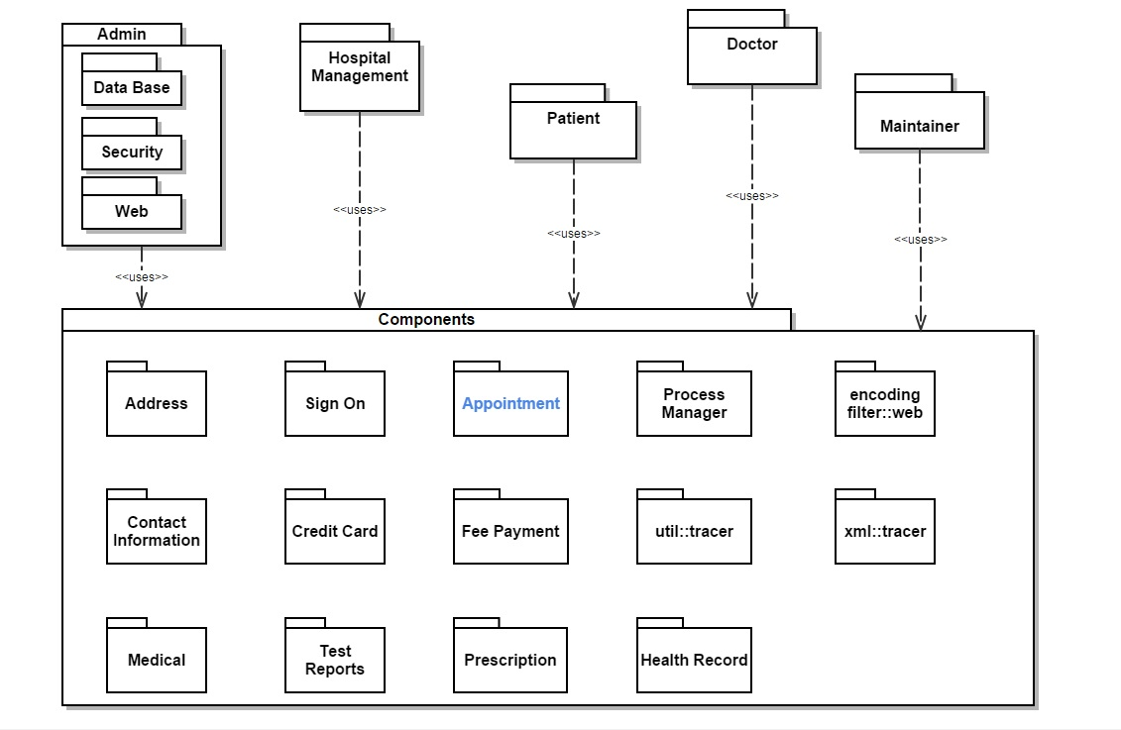
High Level Architecture

Slide 25
Modification to the Architecture
Modified Feature - Appointment Component
Giving the user the opportunity to see the schedule of doctors and ask for/modify/cancel the appointment and state the reason of requesting that appointment
The patient can upload the current state of health status or health vitals

Slide 26
Conclusion
iCare gave us an opportunity to gain insight into the needs of current situations of health care domain.
Not all views need to be included into the architecture description for a particular view model.
Combination of views from different view models better addresses the concerns of various stakeholders.
HIS system can extend primary health care to remote geographical locations.

Slide 27
References
[1] Richard Alvarez, Health care has to move into the hi-tech age, Bulletin of the World Health Organization, Past issues, Volume 83: May 2005, 321-400, URL: http://www.who.int/bulletin/volumes/83/5/editorial20505html/en/.
[2] https://en.wikipedia.org/wiki/Hospital_information_system
[3] http://msdn.microsoft.com/en-us/library/ee658124.aspx/
[4] Images from Google images.

Slide 28
Questions?

